Slide 1

Model Performance Metrics
Notes:
Prompt: Sky full of numbers and equations with data scientists watching in wonder

Slide 2
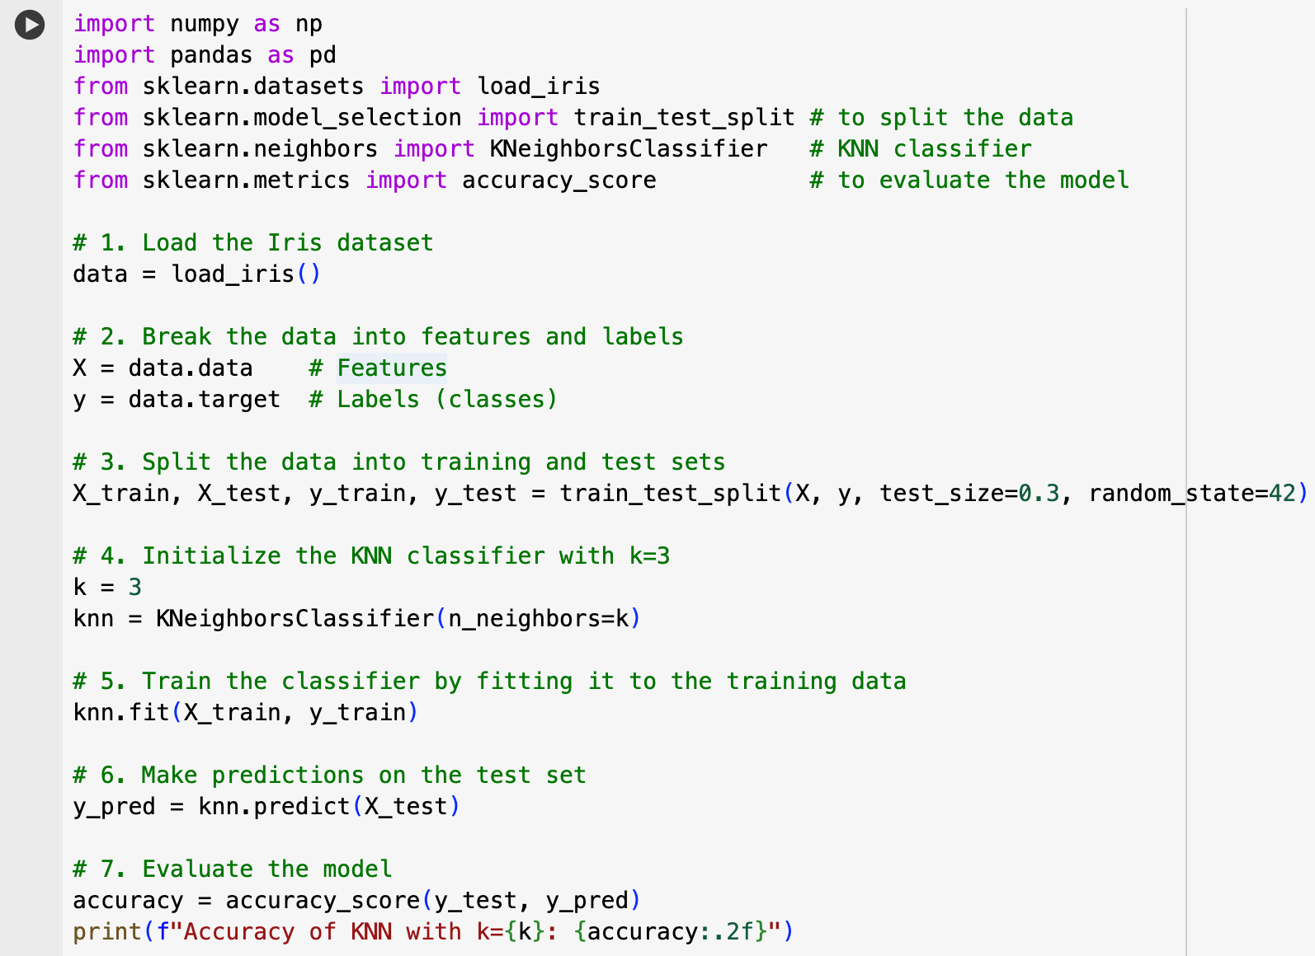
The scikit-Learn Model Development Process
Load the Data set
Break data set into features and target
Create train/test split
Initiate the model
Fit the model to the training data
Use model to make predictions on the test data
Calculate model performance
Notes:
Analogy to Curve Fitting: The term "fit" draws an analogy to curve fitting in mathematics and statistics. In curve fitting, you find the equation of a curve that best passes through a set of data points. Similarly, in machine learning, we're trying to find the model that best "fits" or aligns with the patterns in the training data.
In essence, "fitting" a model is the process of finding the best possible settings for the model to learn the patterns in the training data, with the goal of making accurate predictions on new data.

Slide 3
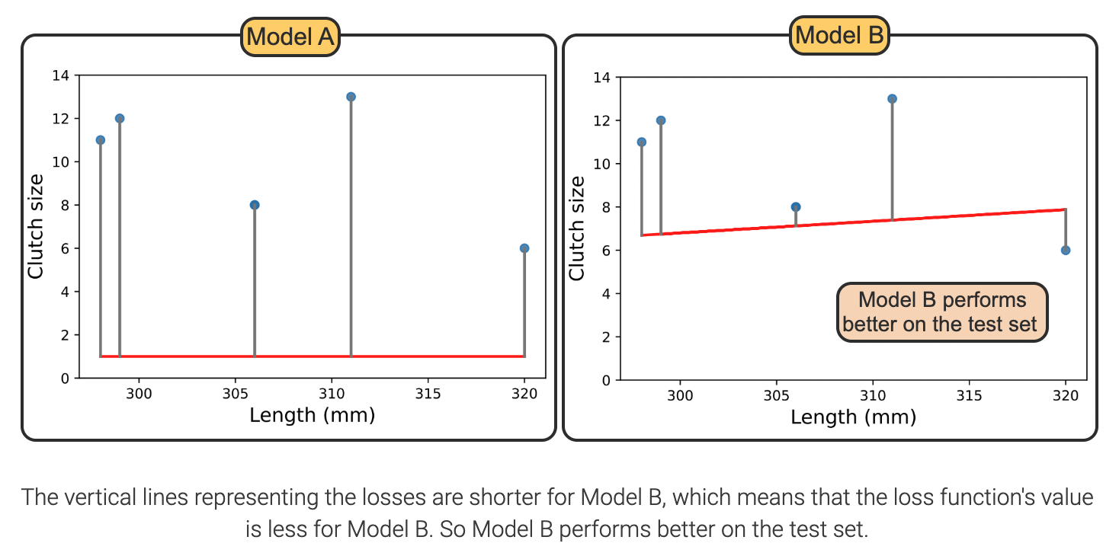
Calculating Loss in regression Problems

Slide 4
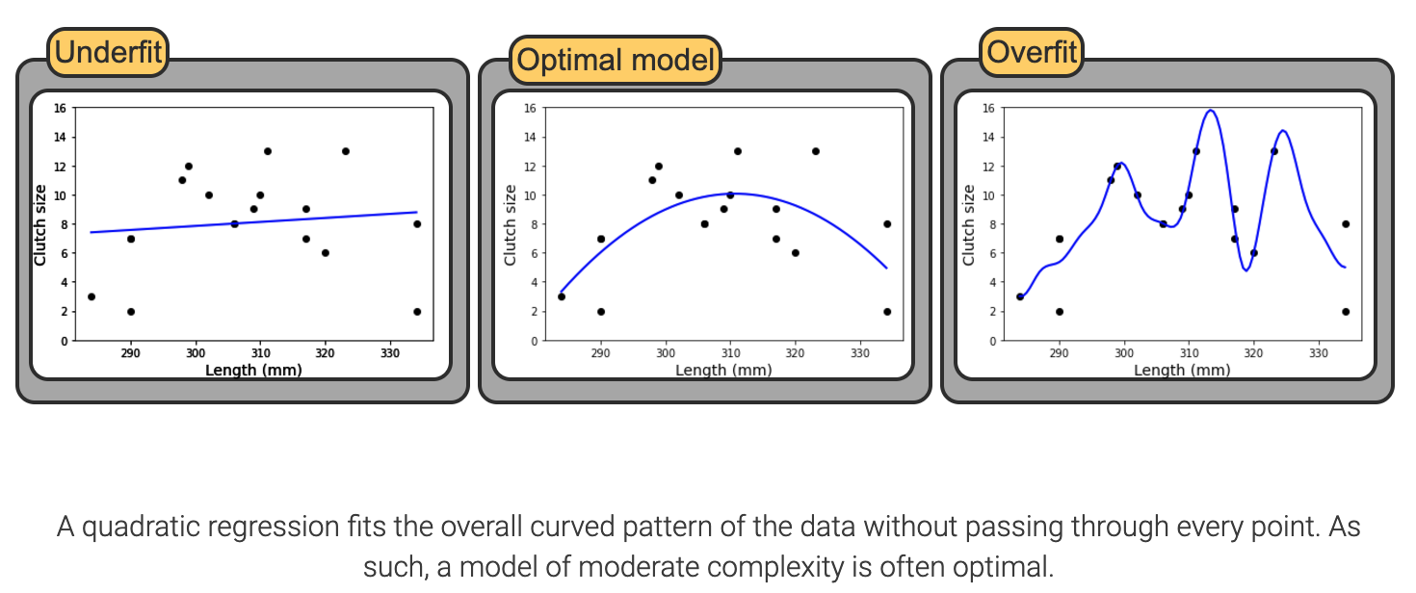
Under- vs Over- Fitting of Data to Models

Slide 5
Bias variance tradeoff

Slide 6
Bias-Variance Tradeoff Definition
Bias and Variance Defined
Bias: Error from oversimplifying a complex problem, leading to underfitting and failure to capture patterns.
Variance: Error from excessive sensitivity to training data, causing overfitting and capturing noise as patterns.
Tradeoff:
The bias-variance tradeoff balances these errors: increasing model complexity reduces bias but raises variance, and vice versa. The goal is to find an optimal complexity that minimizes total error.
Notes:
In machine learning, the bias-variance tradeoff is a fundamental concept that describes the balance between two sources of error that affect a model's performance: bias and variance. Understanding and managing this tradeoff is crucial for developing models that generalize well to new, unseen data.
Bias and Variance Defined
Bias refers to the error introduced by approximating a real-world problem, which may be complex, by a simplified model. High bias can cause a model to miss relevant relations between features and target outputs, leading to underfitting. This means the model is too simple to capture the underlying patterns in the data.
Variance refers to the error introduced by the model's sensitivity to small fluctuations in the training data. High variance can cause a model to model the random noise in the training data rather than the intended outputs, leading to overfitting. This means the model is too complex and captures noise as if it were a true pattern.
The Tradeoff
The bias-variance tradeoff is the balance between the error introduced by bias and the error introduced by variance. As model complexity increases, bias decreases, and variance increases. Conversely, as model complexity decreases, bias increases, and variance decreases. The goal is to find a model with the right level of complexity that minimizes the total error.

Slide 7
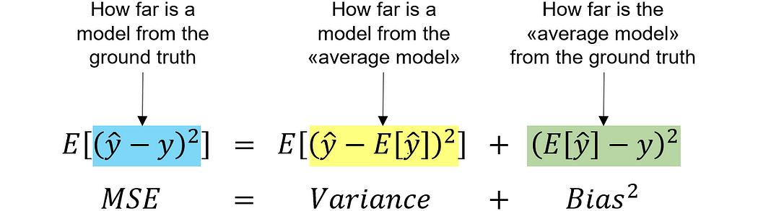
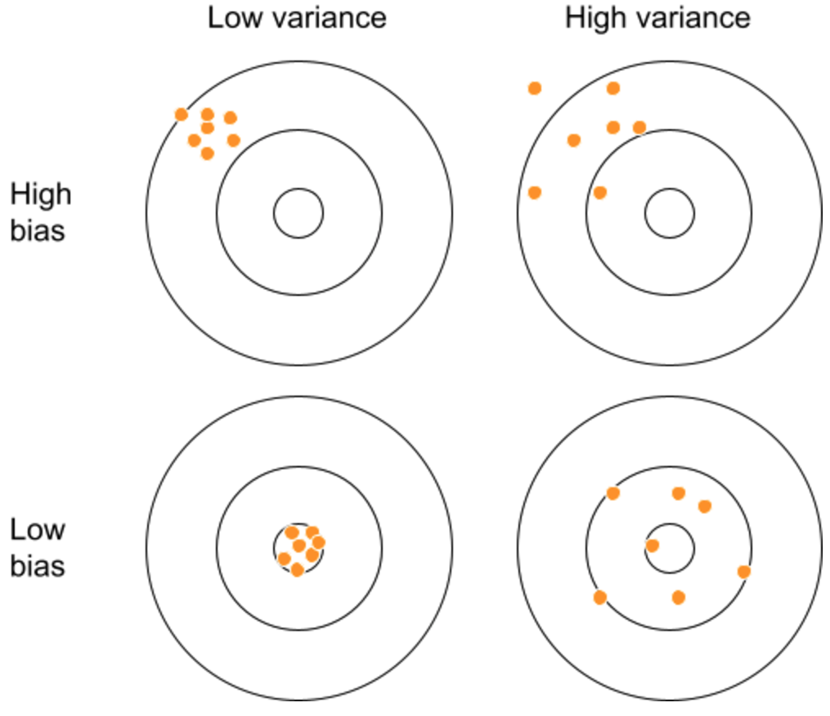
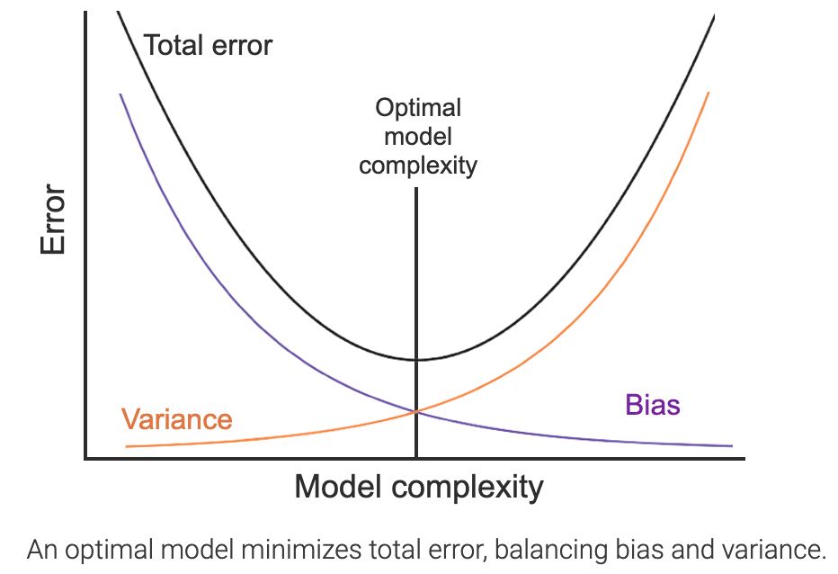
Bias–Variance Tradeoff Concept
Notes:
● Bias is the error introduced when a simplified model is used to approximate a complex real-world problem1. High bias can cause a model to miss important relationships between features and target outputs, leading to underfitting, where the model is too simple to capture data patterns1.
● Variance is the error introduced by the model's sensitivity to small training data fluctuations1. High variance can cause a model to model random noise instead of intended outputs1. This results in overfitting, where the model is too complex and mistakes noise for a true pattern2.
https://medium.com/towards-data-science/the-bias-variance-trade-off-explained-practically-in-python-48cf29d9e900

Slide 8
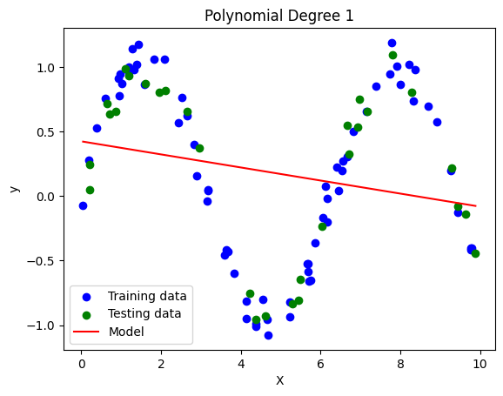
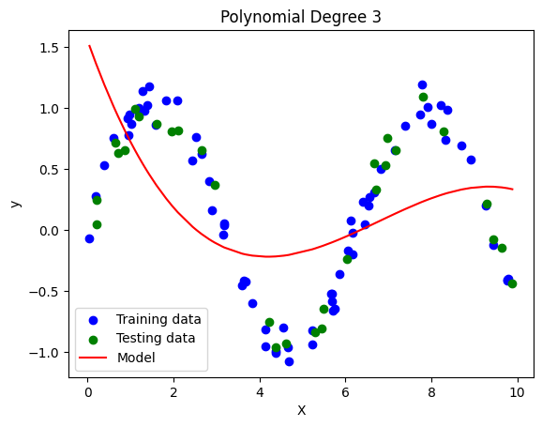
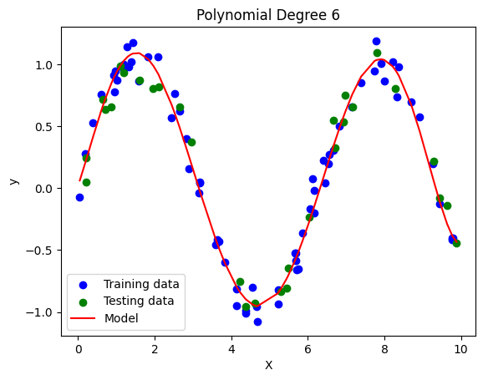
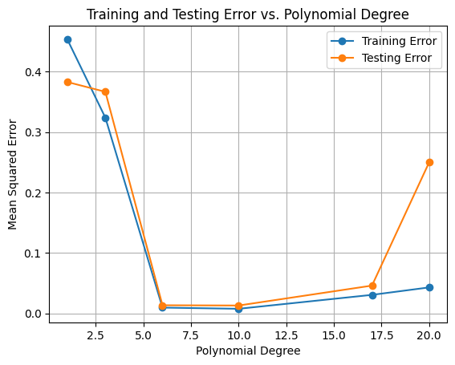
Visualizing the Tradeoff
Visualization: Plot training and validation errors vs. model complexity.
Training error ↓ as model fits training data.
Validation error forms a U-shape — decreases (↓ bias), then increases (↑ variance).
Examples:
Linear regression: High bias, low variance → underfitting
High-degree polynomial: Low bias, high variance → overfitting
Goal: Choose model complexity that balances bias and variance.
Notes:
https://colab.research.google.com/drive/11riF-I9qrakAp7yJjWvOm1KDdYYkwTIp#scrollTo=lHieZ-ktUCzW
The Bias-Variance Tradeoff
The bias-variance tradeoff seeks to balance the errors caused by bias and variance2.
As model complexity increases, bias decreases and variance increases2. Conversely, as model complexity decreases, bias increases, and variance decreases2.
The goal is to find a model with the right complexity level to minimize total error

Slide 9
Train Test Split

Slide 10
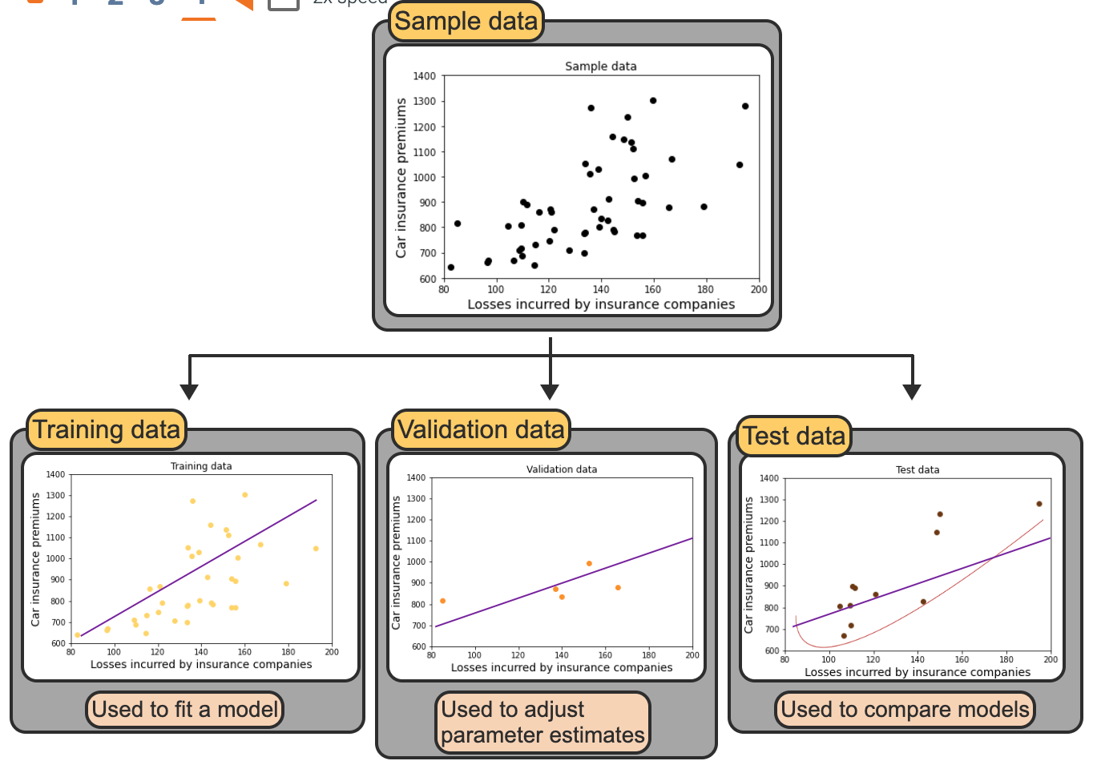
Training, Validation, and Test Data sets
Training data is used to fit a model.
Validation data is used to evaluate model performance while adjusting parameter estimates and conducting feature selection.
Test data is used to evaluate final model performance and compare different models.
Notes:
https://machinelearningmastery.com/difference-test-validation-datasets/
The validation dataset is a subset of the data not used during the model's training phase. Its primary purpose is to provide an unbiased evaluation of a model's performance during hyperparameter tuning. By assessing the model on the validation set, practitioners can identify overfitting or underfitting and adjust hyperparameters accordingly. This iterative process continues until the model achieves optimal performance on the validation data, indicating a good balance between bias and variance.

Slide 11
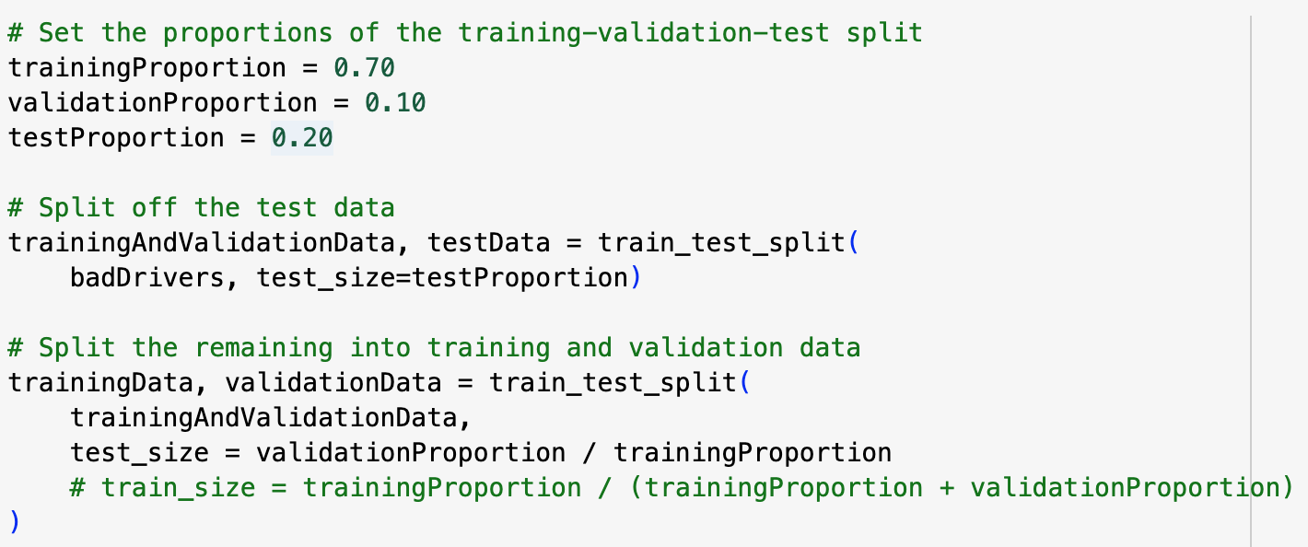
Creating Training, Validation, and Test data sets in Python
train_test_split function splits the original dataset into two parts:
Training / validation
test
test_size contains 20% of the data (as defined by testProportion)
Next part further splits the trainingAndValidationData:
trainingData: contains data for training the model.
validationData: contains data for validating the model's performance during training.
Full Data Set
Training + Validation Data
Testing
Training Data
Validation

Slide 12

Cross-Validation
Split data into k folds (e.g., 5) — each fold takes a turn as validation.
Repeat process k times, then average results for reliable performance.
Ensures the model generalizes well, not just fits one data split.
Validation
Test Data
Test Data
GeeksforGeeks

Slide 13
Regression Metrics

Slide 14
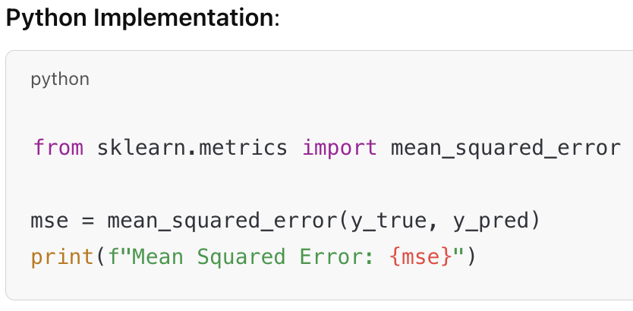
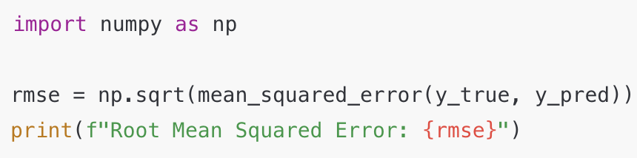
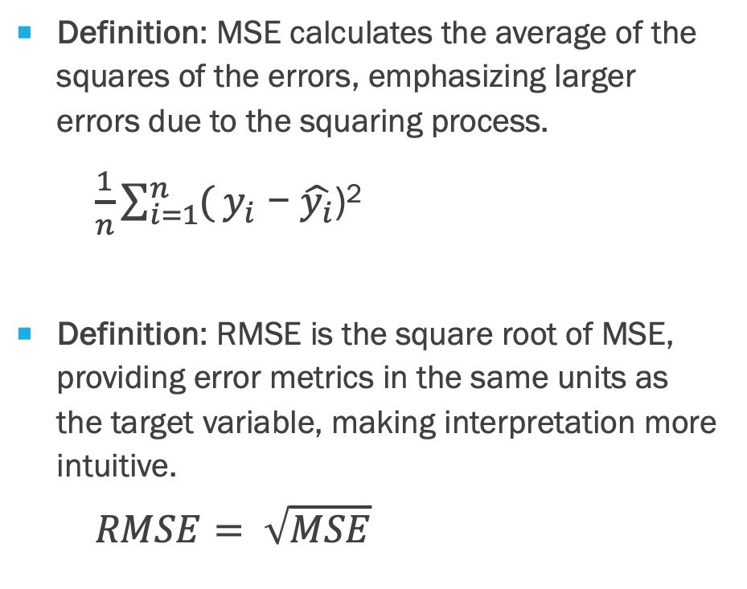
Mean Squared Error (MSE), RMSE
Definition: MSE calculates the average of the squares of the errors, emphasizing larger errors due to the squaring process.
$\frac{1}{n}\sum_{i=1}^{n}{(}y_{i}\text{ − }\hat{y_{i}}\text{)}$²
Definition: RMSE is the square root of MSE, providing error metrics in the same units as the target variable, making interpretation more intuitive.
$$RMSE= \sqrt{MSE}$$

Slide 15
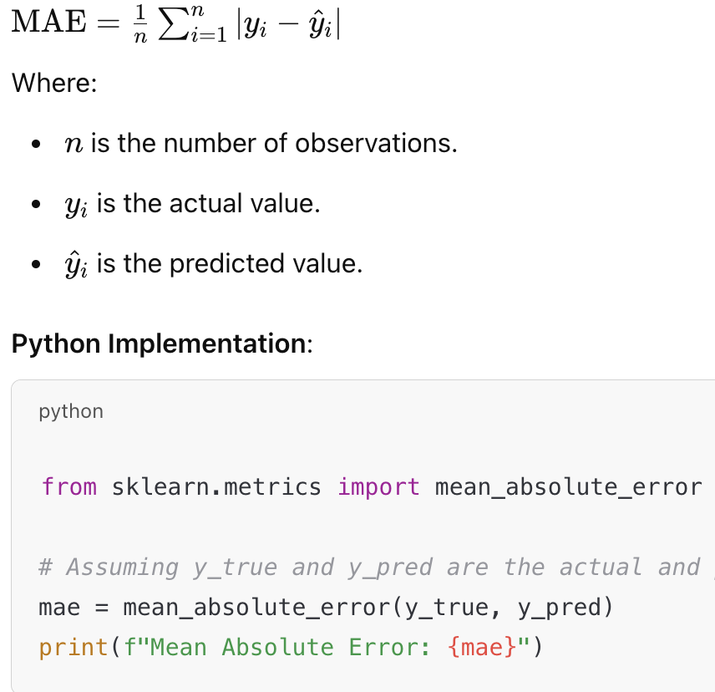
Mean Absolute Error (MAE)
Definition: MAE measures the average magnitude of errors between predicted and actual values, without considering their direction.
Python Implementation:

Slide 16
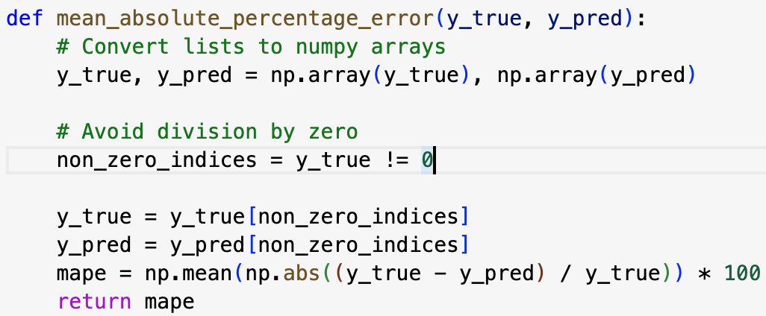
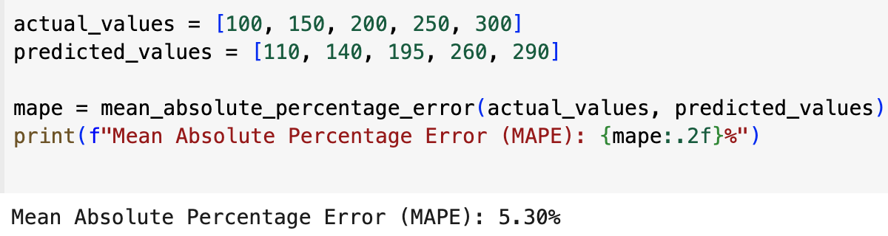
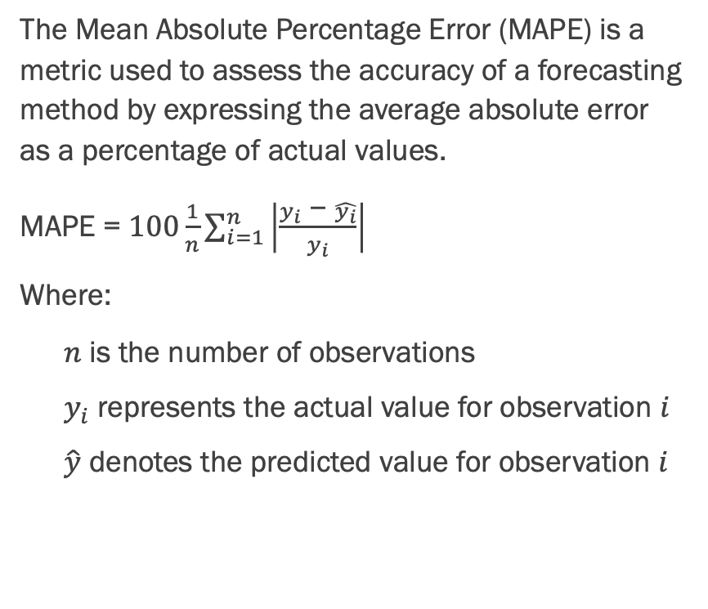
MAPE = Mean Absolute Percentage Error
The Mean Absolute Percentage Error (MAPE) is a metric used to assess the accuracy of a forecasting method by expressing the average absolute error as a percentage of actual values.
MAPE = $100\frac{1}{n}\sum_{i=1}^{n}{\left|\frac{y_{i}\text{ − }\hat{y_{i}}}{y_{i}}\right|}$
Where:
$n$ is the number of observations
$y_{i}$ represents the actual value for observation $i$
$\hat{y}$ denotes the predicted value for observation $i$

Slide 17
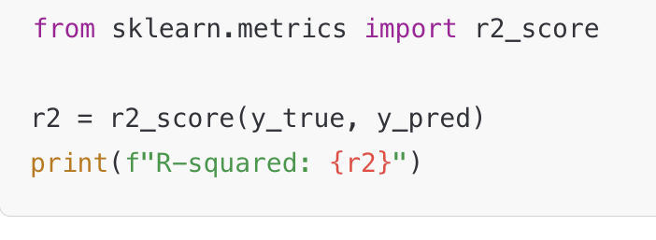
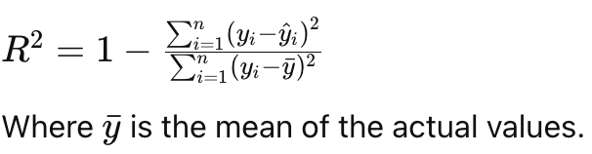
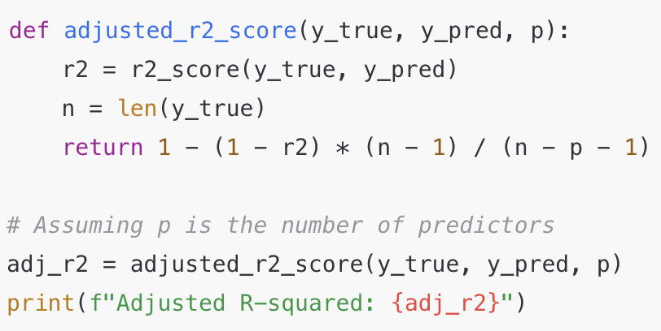
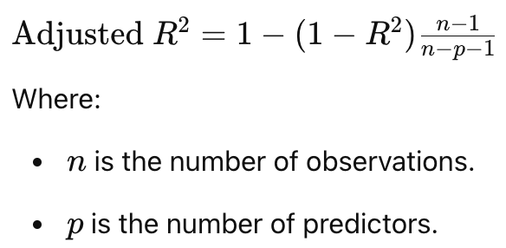
R-Squared, Adjusted R²
Definition: R-squared indicates the proportion of the variance in the dependent variable (target) that is predictable from the independent variables (features).
Definition: Adjusted R-squared adjusts the R-squared value based on the number of features (aka predictors) in the model, providing a more accurate measure when multiple predictors are used.
Python Implementation:
Notes:
In the context of regression analysis, predictors (also known as independent variables) are the variables used to explain variations in the dependent variable. When a regression model includes more than one predictor, it's termed a multiple regression model. The Adjusted R-squared is a statistical measure that adjusts the R-squared value to account for the number of predictors in the model, providing a more accurate assessment of the model's explanatory power.
The Role of Adjusted R-squared
The Adjusted R-squared is a modified version of the R-squared statistic that accounts for the number of predictors in the model. While R-squared measures the proportion of variance in the dependent variable explained by the independent variables, it tends to increase with the addition of more predictors, regardless of their relevance. Adjusted R-squared introduces a penalty for adding predictors that do not improve the model significantly, providing a more accurate measure of model fit.
Using Adjusted R-squared helps prevent overfitting, which occurs when a model becomes too complex by including too many predictors, capturing noise rather than the underlying relationship. By penalizing the addition of irrelevant predictors, Adjusted R-squared provides a more reliable measure of model performance.
In summary, in the definition of Adjusted R-squared, "multiple predictors" refer to the independent variables included in a regression model to explain the variability in the dependent variable. Adjusted R-squared adjusts the R-squared value to account for the number of these predictors, offering a more accurate assessment of the model's explanatory power.

Slide 18
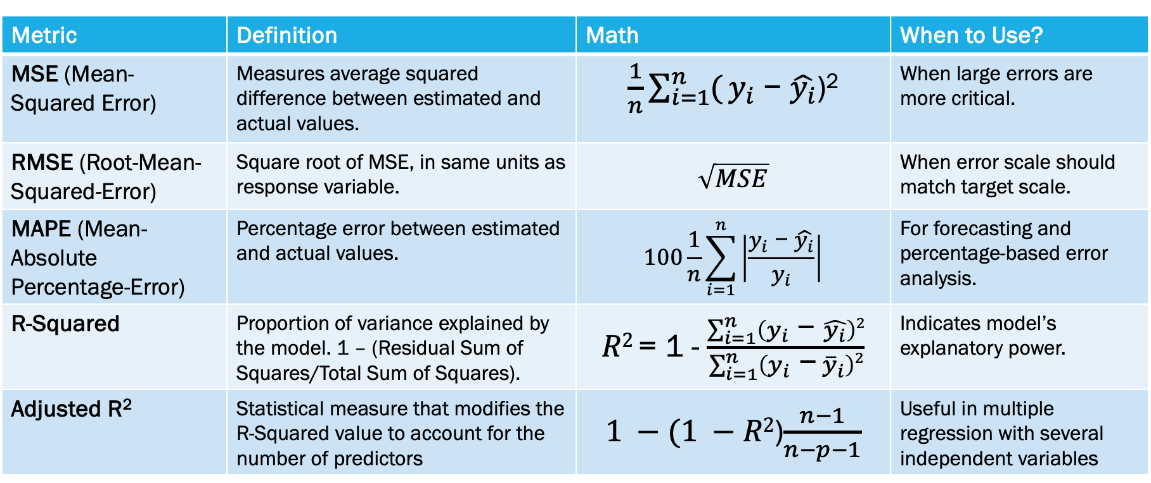
Regression Metrics - Summary
Metric | Definition | Math | When to Use?
MSE (Mean-Squared Error) | Measures average squared difference between estimated and actual values. | $\frac{1}{n}\sum_{i=1}^{n}{(}y_{i}\text{ − }\hat{y_{i}}\text{)}$² | When large errors are more critical.
RMSE (Root-Mean-Squared-Error) | Square root of MSE, in same units as response variable. | $$\sqrt{MSE}$$ | When error scale should match target scale.
MAPE (Mean- Absolute Percentage-Error) | Percentage error between estimated and actual values. | $$100\frac{1}{n}\sum_{i=1}^{n}{\left|\frac{y_{i}\text{ − }\hat{y_{i}}}{y_{i}}\right|}$$ | For forecasting and percentage-based error analysis.
R-Squared | Proportion of variance explained by the model. 1 – (Residual Sum of Squares/Total Sum of Squares). | $R2$ = 1 - $\frac{\sum_{i=1}^{n}{\left(y_{i}\text{ − }\hat{y_{i}}\right)2}}{\sum_{i=1}^{n}{\left(y_{i} \text{−}{ \overline{y}}_{i}\right)2}}$ | Indicates model’s explanatory power.
Adjusted R² | Statistical measure that modifies the R-Squared value to account for the number of predictors | $1 −(1 −R2$)$\frac{n−1}{n−p−1}$ | Useful in multiple regression with several independent variables
Notes:
For R-squared: The numerator, represents the Residual Sum of Squares (RSS), which measures the unexplained variance—the portion of the total variance not captured by the model.
The denominator, is the Total Sum of Squares (TSS), indicating the total variance in the observed data.
By subtracting the ratio of RSS to TSS from 1, R² indicates the fraction of the total variance that the model explains. An R² value of 0 means the model explains none of the variance, while an R² of 1 indicates the model explains all the variance. Values between 0 and 1 reflect the proportion of variance explained by the model.

Slide 19
Classification Metrics

Slide 20
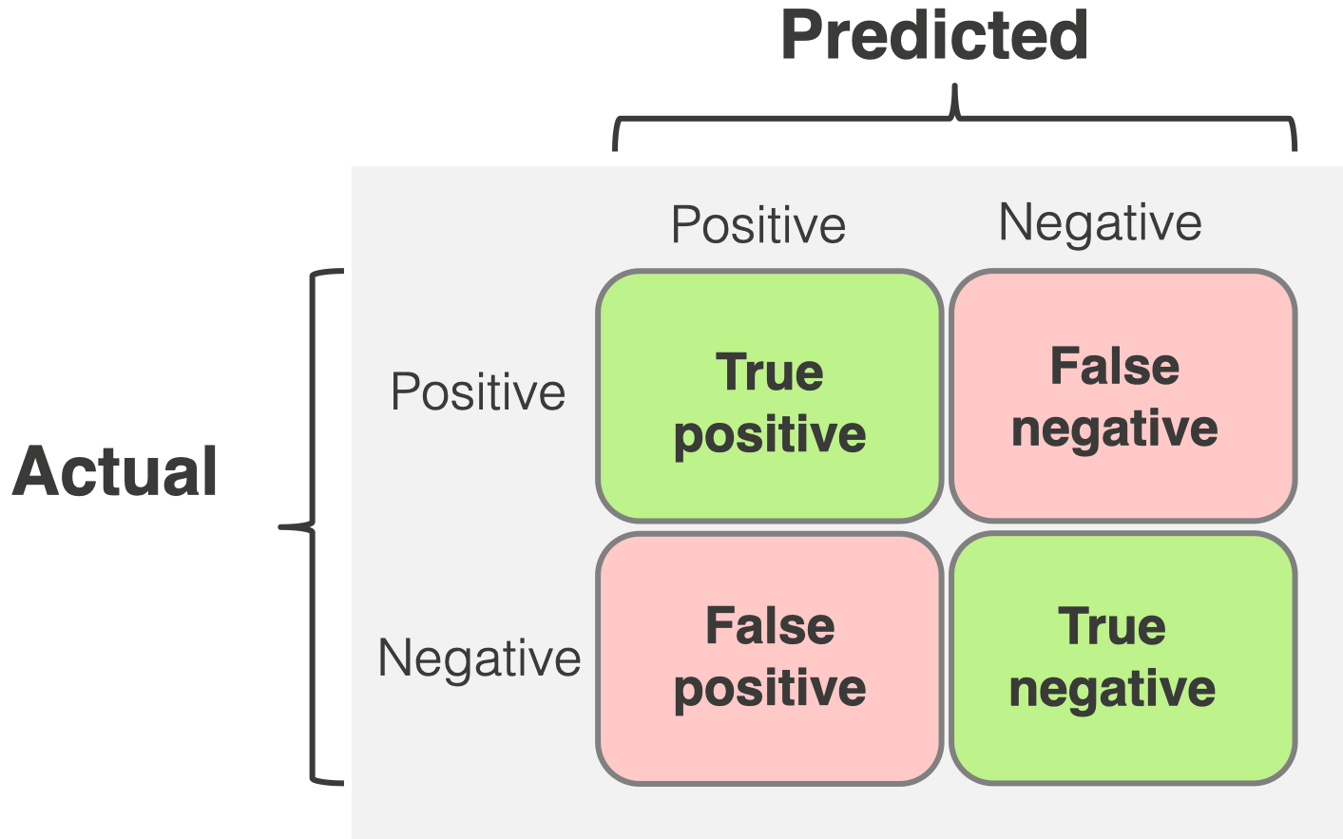
Measuring Model Performance with the Confusion Matrix
A confusion matrix is a N x N matrix where N is total number of target categories (2 x 2 = Binary).
It compares actual target values to those predicted by the ML model.
Prediction results can be put into four categories:
TP (True Positive): Correctly predicted positive instances.
TN (True Negative): Correctly predicted negative instances.
FP (False Positive): Negative instances incorrectly predicted as positive.
FN (False Negative): Positive instances incorrectly predicted as negative.
Notes:
See an excellent tutorial on the confusion matrix at: https://www.evidentlyai.com/classification-metrics/confusion-matrix

Slide 21
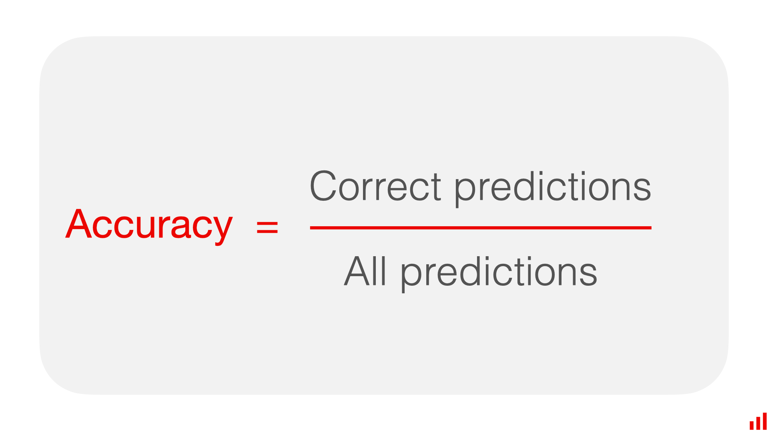
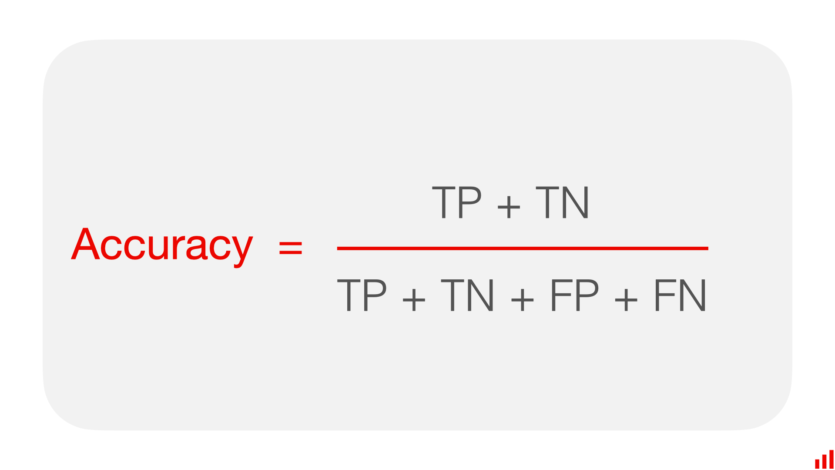
Accuracy
When is model accuracy NOT a good measure of performance?
Notes:
Pros:
Accuracy is a helpful metric when you deal with balanced classes and care about the overall model “correctness” and not the ability to predict a specific class.
Accuracy is easy to explain and communicate.
Cons:
If you have imbalanced classes, accuracy is less useful since it gives equal weight to the model’s ability to predict all categories.
Communicating accuracy in such cases can be misleading and disguise low performance on the target class.

Slide 22
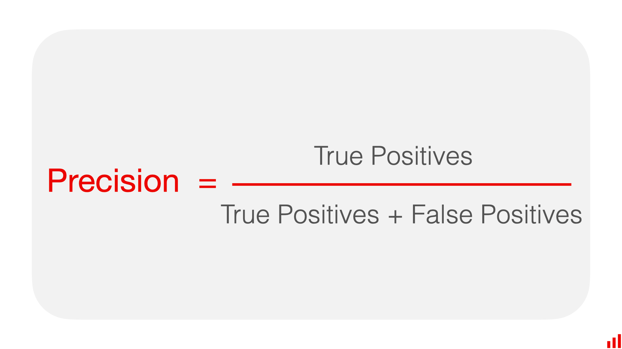
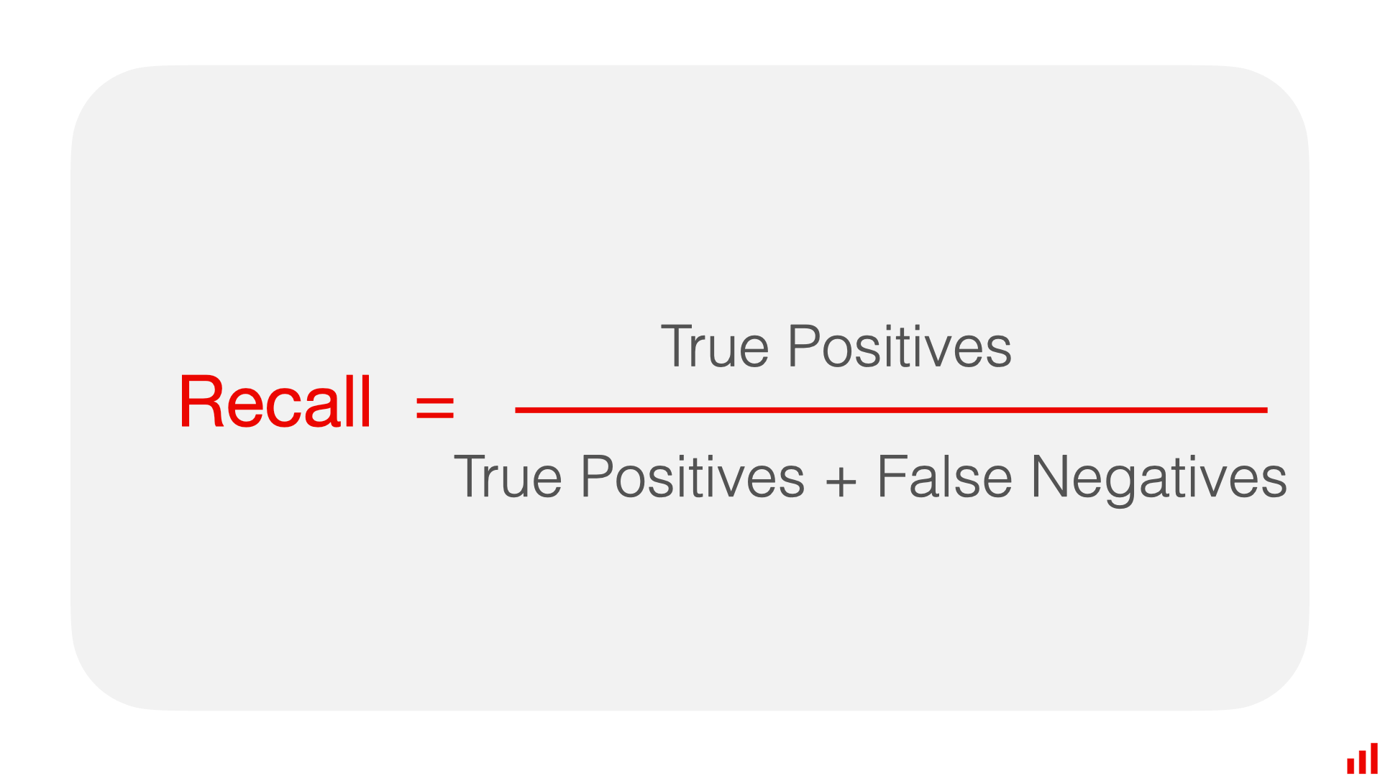
Precision and Recall
Precision is a metric that measures how often a machine learning model correctly predicts the positive class.
Recall is a metric that measures how often a machine learning model correctly identifies positive instances (true positives) from all the actual positive samples in the dataset. (True Positive Rate)
Notes:
Pros of precision metric:
It works well for problems with imbalanced classes since it shows the model correctness in identifying the target class.
Precision is useful when the cost of a false positive is high. In this case, you typically want to be confident in identifying the target class, even if you miss out on some (or many) instances.
Con of precision:
Precision does not consider false negatives. Meaning: it does not account for the cases when we miss our target event!
Here are the pros of the recall metric:
It works well for problems with imbalanced classes since it is focused on the model’s ability to find objects of the target class.
Recall is useful when the cost of false negatives is high. In this case, you typically want to find all objects of the target class, even if this results in some false positives (predicting a positive when it is actually negative).

Slide 23
Precision-Recall Tradeoff Examples
1. Medical Diagnostics (Want High Recall)
Catch all true cases (↓ false negatives).
May increase false positives.
2. Email Spam Filtering (Want High Precision)
Avoid flagging real emails as spam.
May miss some spam messages.
3. Fraud Detection in Finance
High recall catches more fraud.
High precision reduces false alarms.
5. Product Recommendation Systems
High precision: relevant suggestions.
High recall: diverse recommendations.

Slide 24

Notes:
https://www.amazon.com/spy-trinkets-Collection-1-4cm-Set/dp/B09FT8SYSX?th=1

Slide 25
Eye Spy - Recall
Name all items you can remember that represent animals.
Name all items you can remember that are edible.

Slide 26
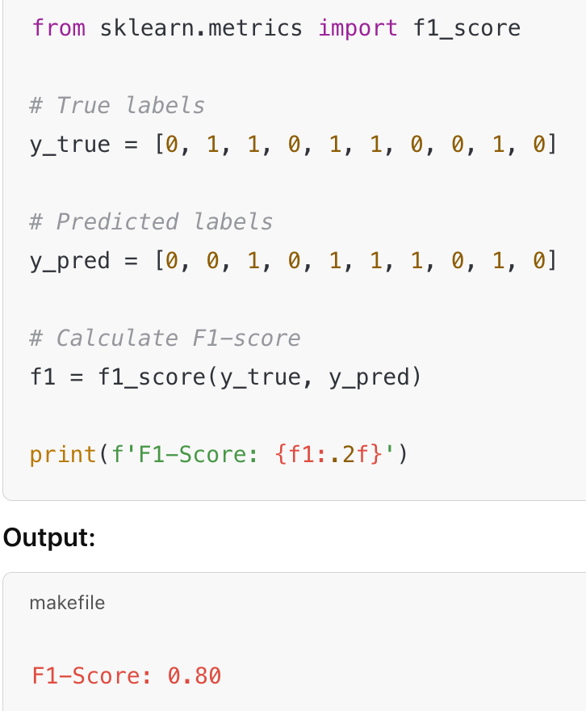
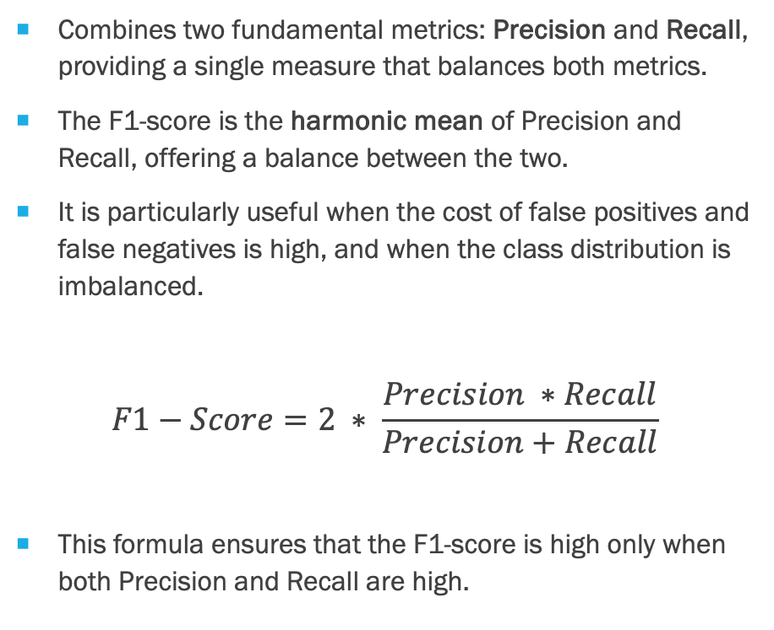
F1-Score
Combines two fundamental metrics: Precision and Recall, providing a single measure that balances both metrics.
The F1-score is the harmonic mean of Precision and Recall, offering a balance between the two.
It is particularly useful when the cost of false positives and false negatives is high, and when the class distribution is imbalanced.
$$F1−Score=2 ∗ \frac{Precision ∗Recall}{Precision+Recall}$$
This formula ensures that the F1-score is high only when both Precision and Recall are high.

Slide 27
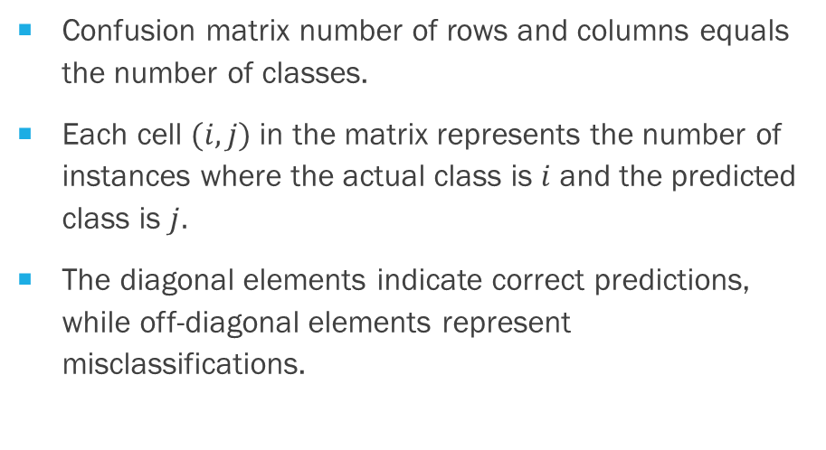
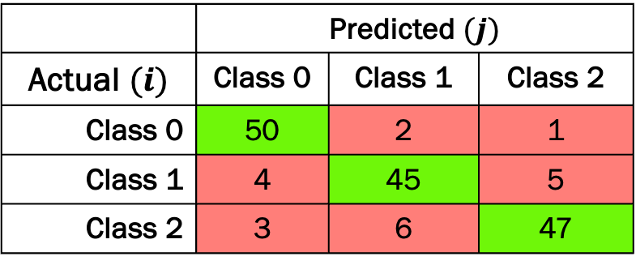
Multiclass Confusion matrix
Confusion matrix number of rows and columns equals the number of classes.
Each cell $(i, j)$in the matrix represents the number of instances where the actual class is $i$ and the predicted class is $j.$
The diagonal elements indicate correct predictions, while off-diagonal elements represent misclassifications.
 | Predicted $(j)$
Actual $(i)$ | Class 0 | Class 1 | Class 2
Class 0 | 50 | 2 | 1
Class 1 | 4 | 45 | 5
Class 2 | 3 | 6 | 47
In this matrix:
True Positives (TP): Diagonal elements (e.g., 50 for Class 0).
False Positives (FP): Sum of the corresponding column minus the diagonal element.
False Negatives (FN): Sum of the corresponding row minus the diagonal element.
What is the Accuracy, Precision, Recall?

Slide 28
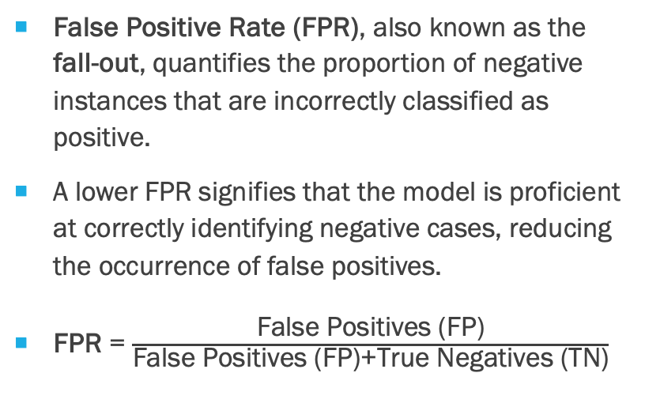
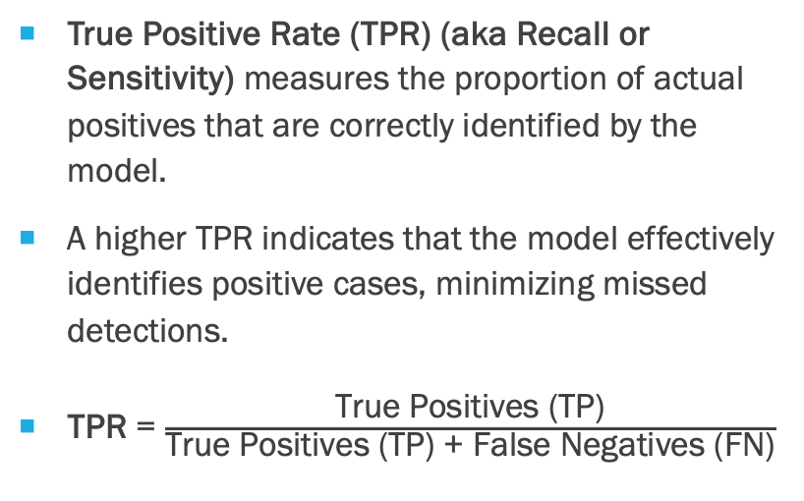
True Positive Rate (TPR) and False Positive Rate (FPR)
True Positive Rate (TPR) (aka Recall or Sensitivity) measures the proportion of actual positives that are correctly identified by the model.
A higher TPR indicates that the model effectively identifies positive cases, minimizing missed detections.
TPR = $\frac{\text{True} \text{Positives}\text{ (}\text{TP}\text{)}}{\text{True} \text{Positives}\text{ (}\text{TP}\text{) + }\text{False} \text{Negatives}\text{ (}\text{FN}\text{)}}$
False Positive Rate (FPR), also known as the fall-out, quantifies the proportion of negative instances that are incorrectly classified as positive.
A lower FPR signifies that the model is proficient at correctly identifying negative cases, reducing the occurrence of false positives.
FPR = $\frac{\text{False} \text{Positives}\text{ (}\text{FP}\text{)}}{\text{False} \text{Positives}\text{ (}\text{FP}\text{)+}\text{True} \text{Negatives}\text{ (}\text{TN}\text{)}}$
An ideal model aims for a high TPR (close to 1) and a low FPR (close to 0), indicating effective detection of positives with minimal false positives.

Slide 29
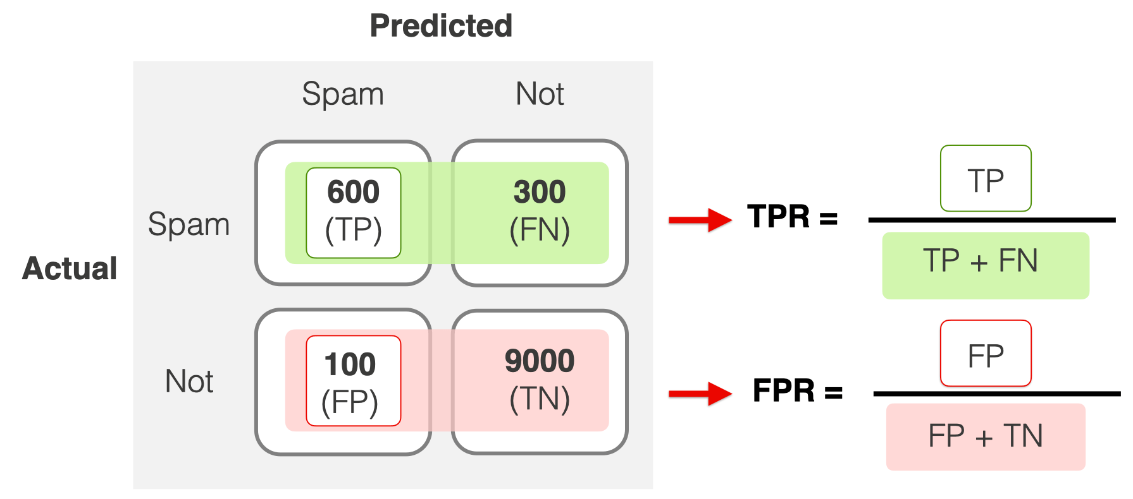
Example TPR and FPR
Notes:
https://www.evidentlyai.com/classification-metrics/explain-roc-curve
FPR (False Positive rate) shows the share of objects falsely assigned a positive class out of all objects of the negative class. For example, the proportion of legitimate emails falsely labeled as spam.
You can calculate the FPR by dividing the number of False Positives by the total number of objects of the negative class in the dataset.
You can think of the FPR as a "false alarm rate."

Slide 30
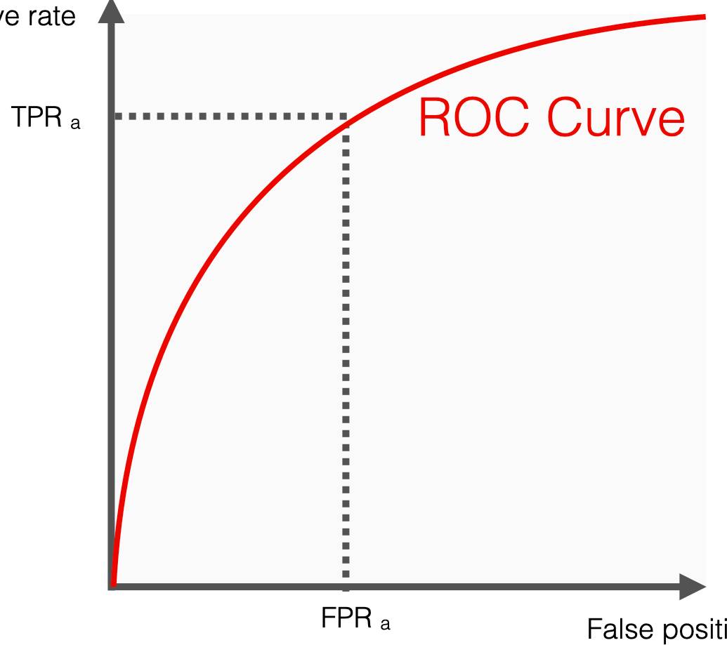
ROC Curve
The ROC curve stands for the Receiver Operating Characteristic curve.
It is a graphical representation of the performance of a binary classifier at different classification thresholds.
The curve plots the possible True Positive rates (TPR) against the False Positive rates (FPR).
Each point on the curve represents a specific classification threshold with a corresponding True Positive rate and False Positive rate.
True Positive Rate
False Positive Rate

Slide 31
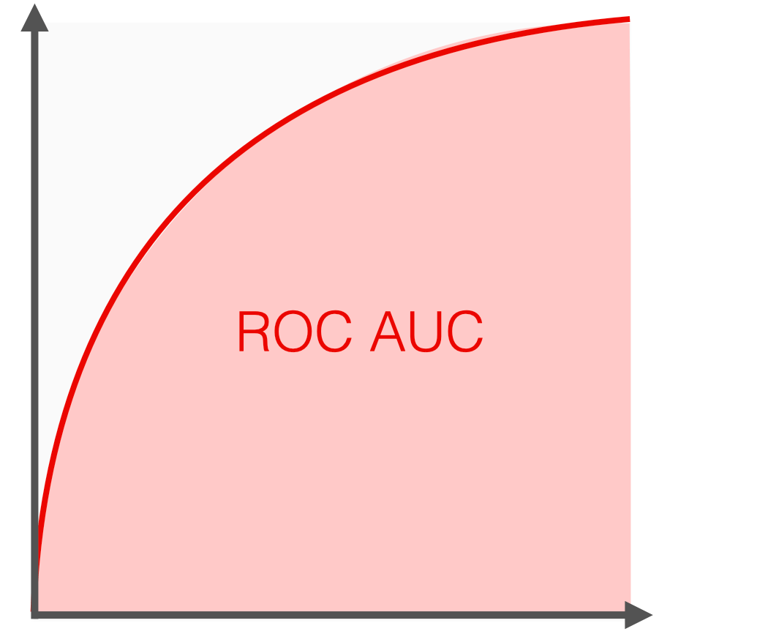
ROC AUC
ROC AUC stands for Receiver Operating Characteristic Area Under the Curve.
ROC AUC score is a single number that summarizes the classifier's performance across all possible classification thresholds.
To get the score, you must measure the area under the ROC curve.
ROC AUC score shows how well the classifier distinguishes positive and negative classes. It can take values from 0 to 1.
A higher ROC AUC indicates better performance. A perfect model would have an AUC of 1, while a random model would have an AUC of 0.5.
True Positive Rate
False Positive Rate

Slide 32
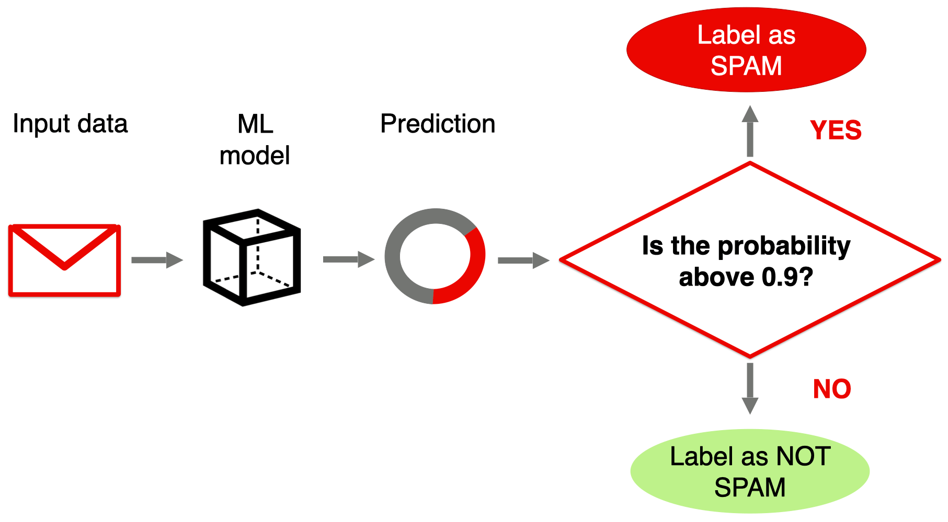
Classification Threshold
Classification Threshold

Slide 33
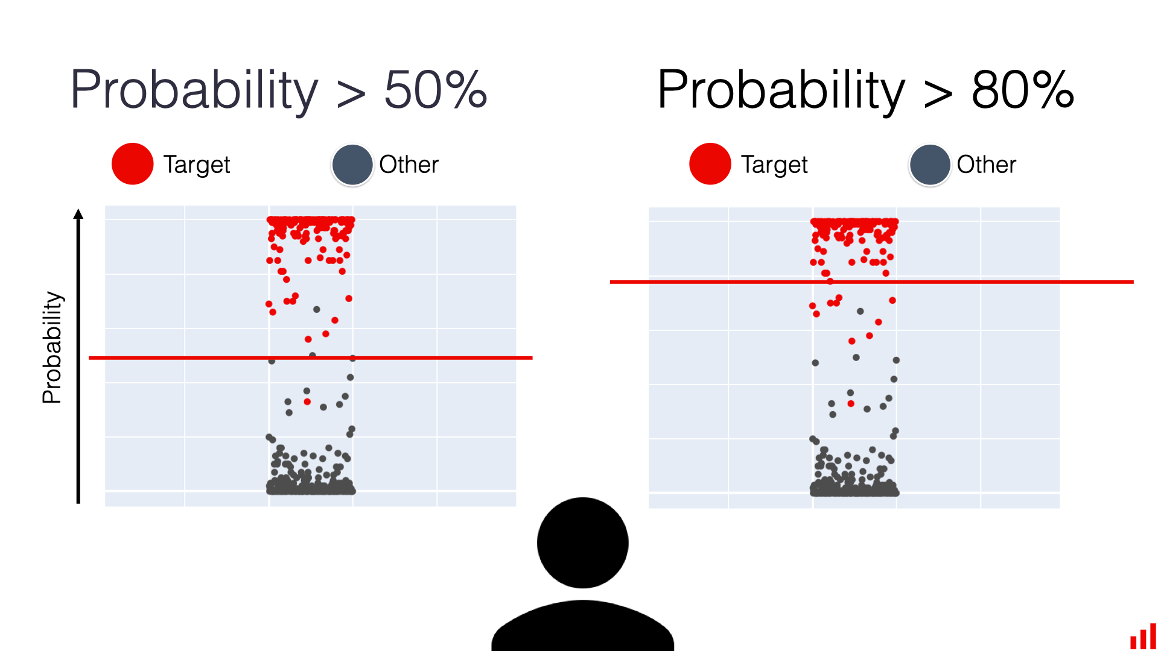
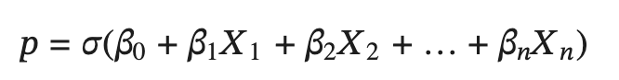
Classification Threshold
You need a classification threshold to convert the output of a probabilistic classifier into class labels.
The threshold determines the minimum probability required for a positive prediction.
Different thresholds can lead to different trade-offs between precision and recall.
The 0.5 threshold is often a default choice, but it might not be optimal in real-world problems.
This depends on the specific task and the cost of false positives and false negatives errors.
Notes:
A probabilistic classification model returns a number from 0 to 1 for each object. For example, for each email, it predicts how likely this email is spam. For a given email, it can be 0.1, 0.55, 0.99, or any other number.
You then have to decide at which probability you convert this prediction to a label. For instance, you can label all emails with a predicted probability of over 0.5 as spam. Or, you can only apply this decision when the score is 0.8 or higher.
This choice is what sets the classification threshold.

Slide 34
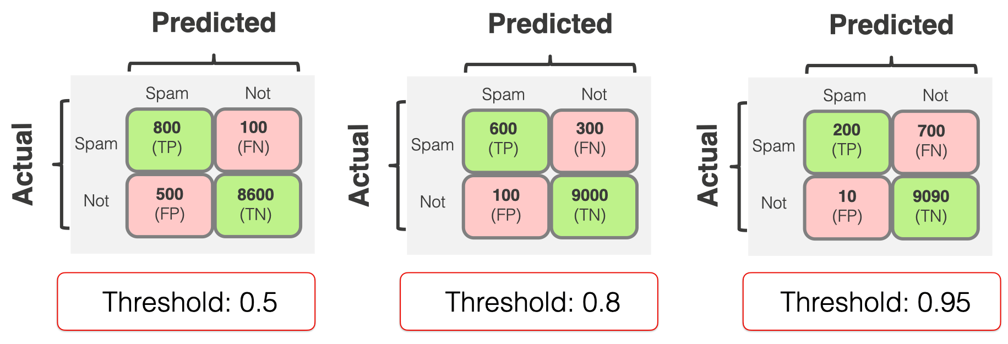
Results of different thresholds
Notes:
As you change the threshold, you will usually get new combinations of errors of different types (and new confusion matrices)!
When you set the threshold higher, you make the model "more conservative." It assigns the True label when it is "more confident." But as a consequence, you typically lower recall: you detect fewer examples of the target class overall.
When you set the threshold lower, you make the model "less strict." It assigns the True label more often, even when "less confident." Consequently, you increase recall: you will detect more examples of the target class. However, this may also lead to lower precision, as the model may make more False Positive predictions.
TPR and FPR change in the same direction. The higher the recall (TPR), the higher the rate of false positive errors (FPR). The lower the recall, the fewer false alarms the model gives.

Slide 35
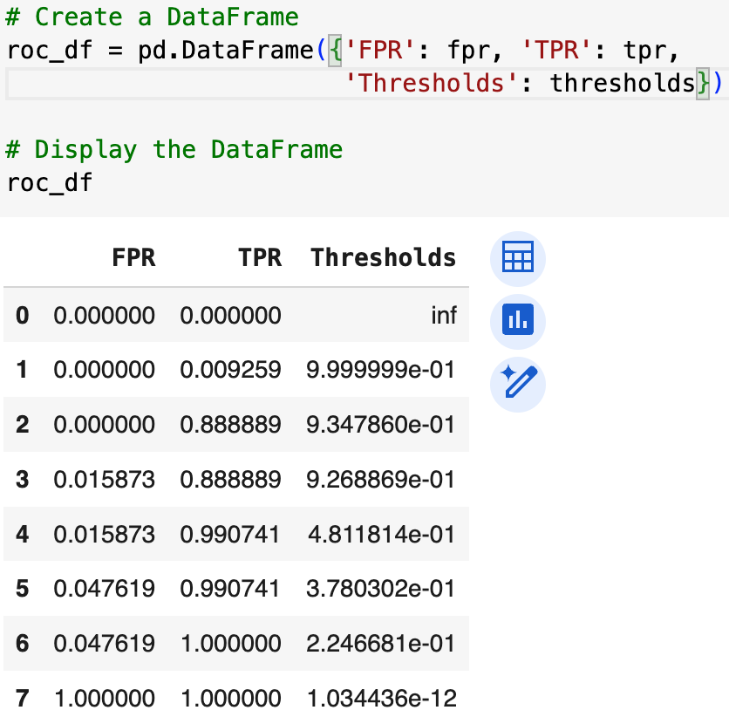
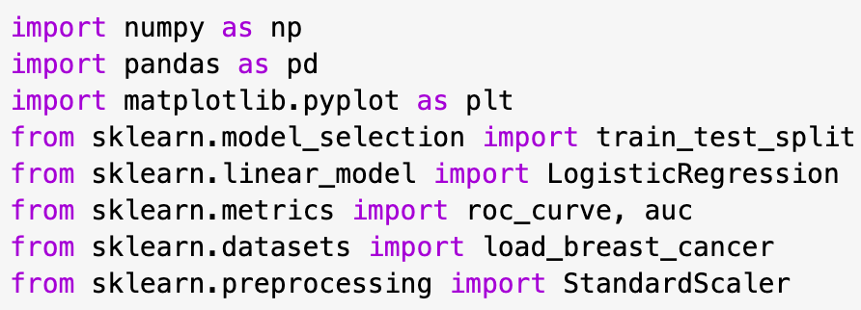
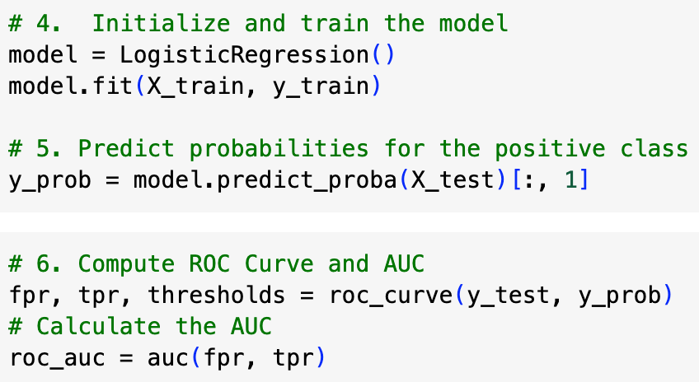
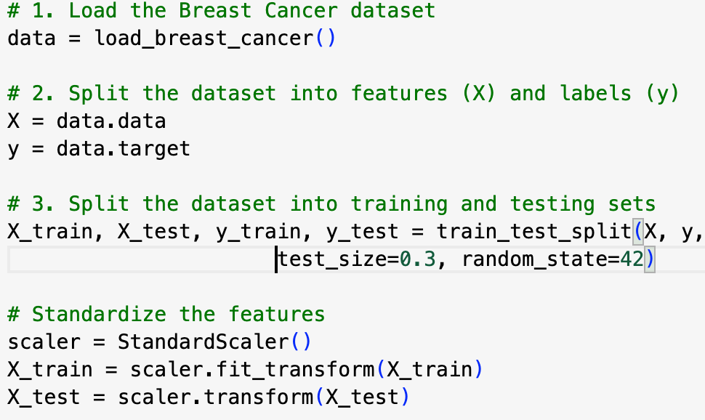
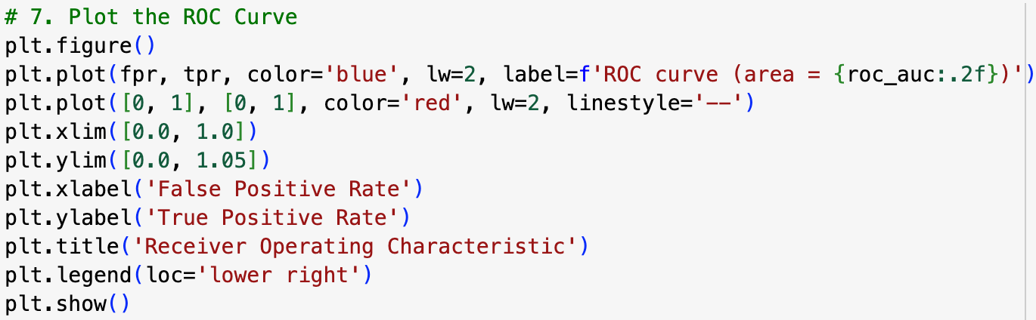
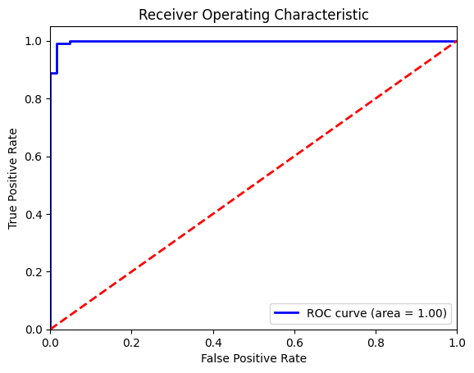
ROC Curve Python Example
https://colab.research.google.com/drive/16DoMKs2_VVf5DoMXqtr4atTSi6Ij4PUd#scrollTo=SntAkaLG2aN9

Slide 36
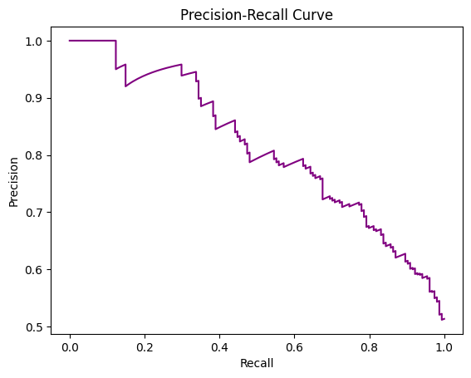
Precision – Recall Curve
The precision-recall curve plots precision (y-axis) against recall (x-axis) for different threshold values.
Precision-recall curves are beneficial when dealing with imbalanced datasets, where the positive class is rare.
In these scenarios, traditional metrics like accuracy can be misleading, as a model might achieve high accuracy by simply predicting the majority class.
The precision-recall curve provides a more nuanced evaluation, focusing on the performance of the minority class.

Slide 37
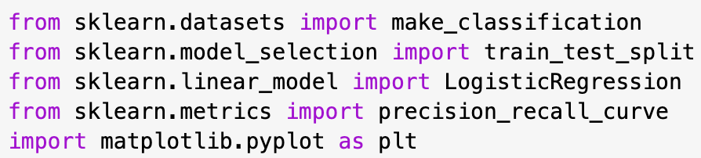



Precision-Recall Curve Python Code
The predict_proba method returns an array of probabilities, where each row represents a data point in X_test, and each column represents the probability of belonging to a specific class.
In a binary classification problem, there will be two columns, one for each class (usually 0 and 1).
[:, 1] selects all rows (:), and only the second column (1).
Python uses 0-based indexing, so the second column corresponds to the probabilities of the positive class (class 1).
Notes:
https://colab.research.google.com/drive/1cENLNjg675vOCtMOFLEjBCEezx90vaGi#scrollTo=uvWmlG5HNLQz

Slide 38
Summary
This lecture provided a comprehensive overview of various model performance metrics, emphasizing their importance in evaluating and comparing machine learning models. Understanding these metrics is crucial for building and deploying effective models in various applications. Some of the main topics discussed included:
Understanding Model Fit: Bias-Variance Tradeoff
Data Splitting: Ensuring Model Generalization
Regression Metrics: Measuring Prediction Accuracy
Classification Metrics: Evaluating Predictive Power
ROC Curve and AUC: Visualizing and Quantifying Classifier Performance
Precision-Recall Curve: Focusing on Positive Predictions

Slide 39
Quiz
Instructions: Answer the following questions in 2-3 sentences each.
Explain the difference between bias and variance in the context of machine learning.
What is the purpose of splitting data into training, validation, and test sets?
Describe the advantages of using RMSE over MSE as a regression metric.
When is accuracy not a reliable metric for evaluating model performance?
What are the four categories of prediction results in a confusion matrix?
Differentiate between precision and recall.
Why is the F1-score considered a balanced metric?
How does a ROC curve visualize the performance of a binary classifier?
Explain the concept of a classification threshold and its influence on precision and recall.
What are the benefits of using cross-validation in model evaluation?

